Slide 1
Hoa Mặt Trời
Notes:
Ms Huyền Phạm - 0936.082.789 – YOUTUBE: MsPham. Facebook: Dạy và học cùng công nghệ.

Slide 2
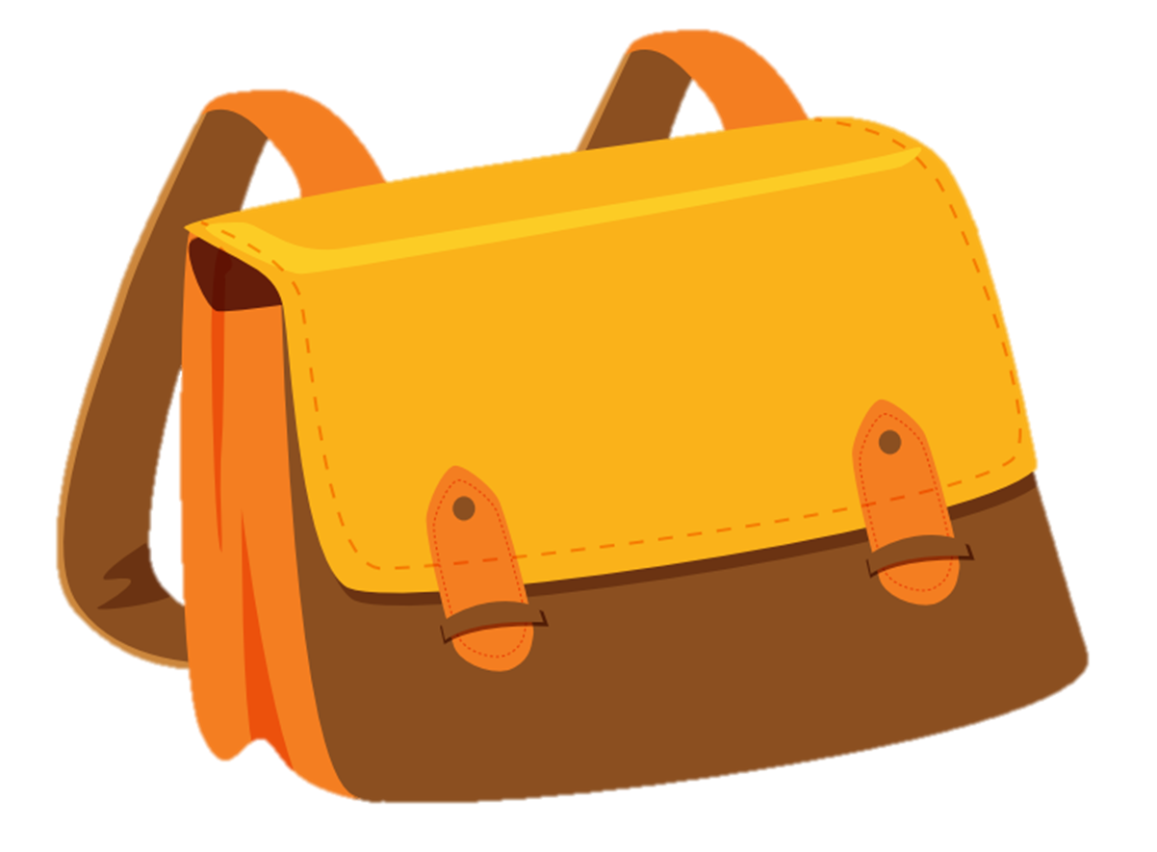
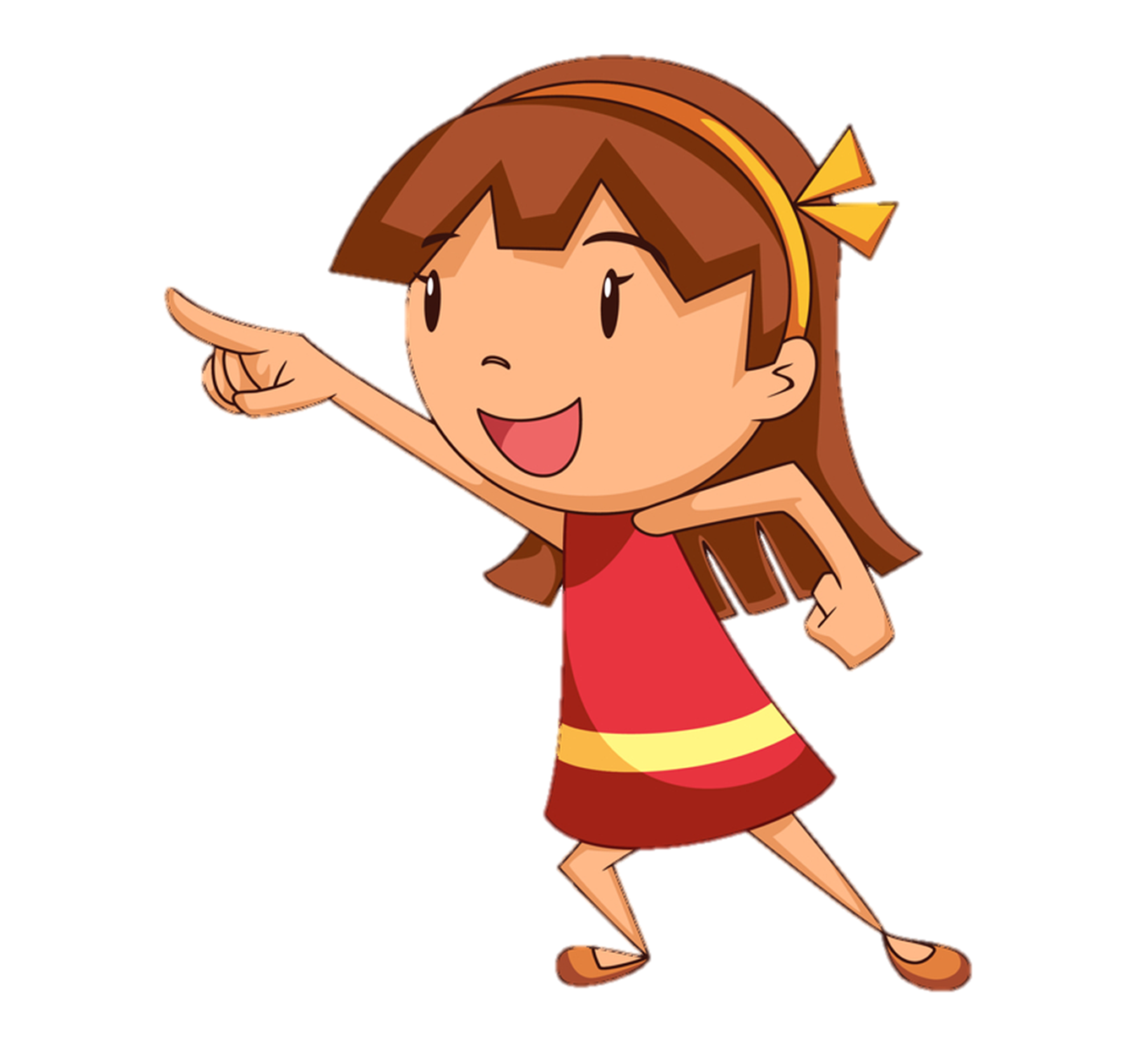
Is that a bag?
A
B
Yes, it is.
No, it isn’t.
Notes:
Ms Huyền Phạm - 0936.082.789 – YOUTUBE: MsPham. Facebook: Dạy và học cùng công nghệ.

Slide 3
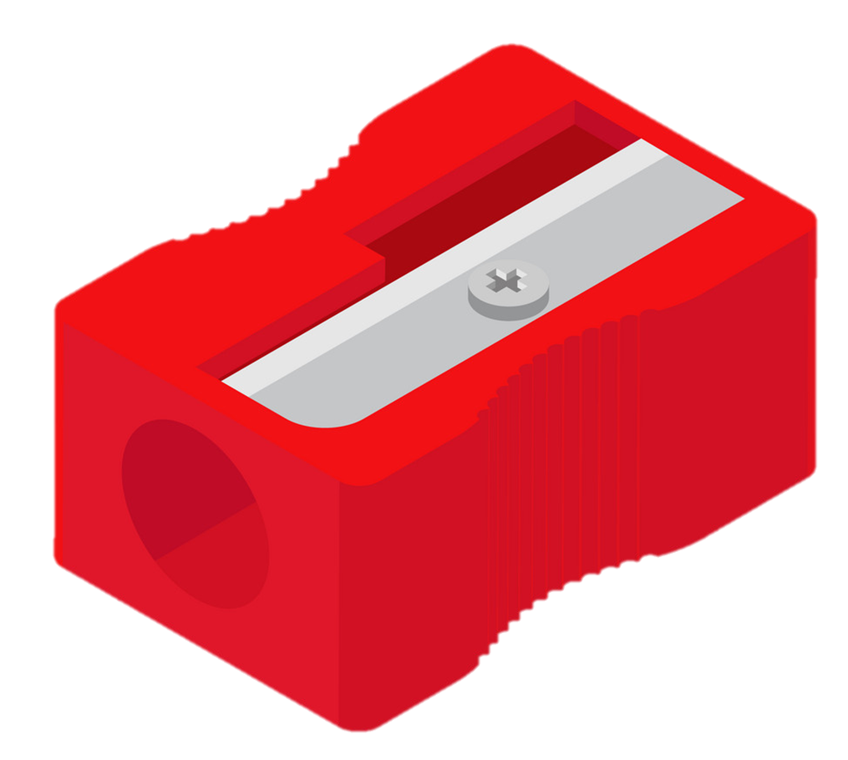
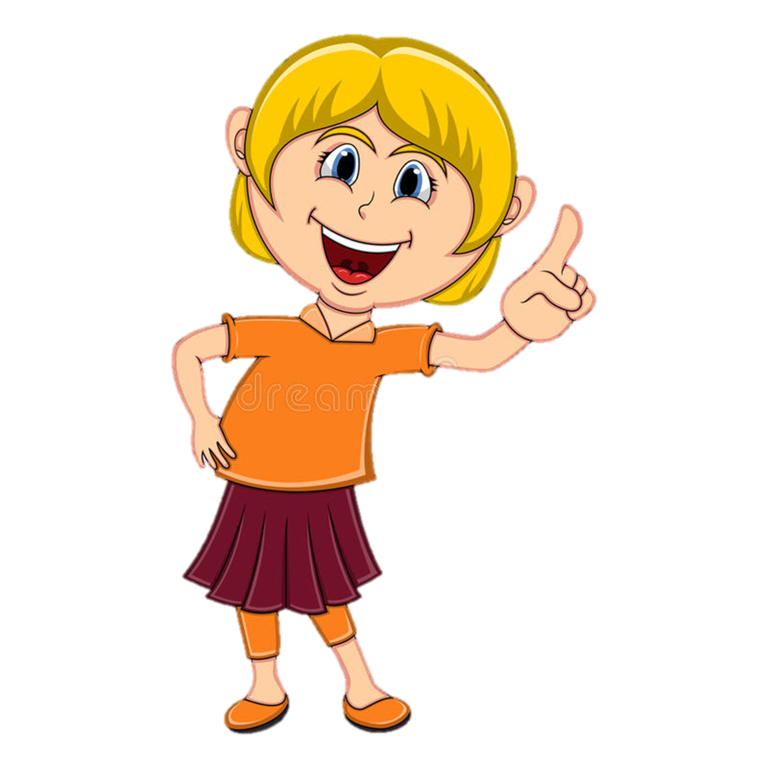
Is this a bag?
A
B
Yes, it is.
No, it isn’t. It’s a pencil sharpener.
Notes:
Ms Huyền Phạm - 0936.082.789 – YOUTUBE: MsPham. Facebook: Dạy và học cùng công nghệ.

Slide 4
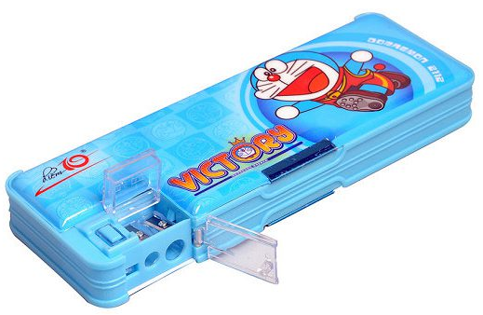
Is this a pen?
A
B
Yes, it is.
No, it in’t.
Notes:
Ms Huyền Phạm - 0936.082.789 – YOUTUBE: MsPham. Facebook: Dạy và học cùng công nghệ.

Slide 5
Is this a pencil?
A
B
No, it isn’t.
Yes, it is.
Notes:
Ms Huyền Phạm - 0936.082.789 – YOUTUBE: MsPham. Facebook: Dạy và học cùng công nghệ.

Slide 6
Is that a pencil sharpener ?
A
B
Yes, it is.
No, it isn’t.
Notes:
Ms Huyền Phạm - 0936.082.789 – YOUTUBE: MsPham. Facebook: Dạy và học cùng công nghệ.

Slide 7
Is this / that pen?
your
a
Yes, it is. / No, it isn’t.
Notes:
Ms Huyền Phạm - 0936.082.789 – YOUTUBE: MsPham. Facebook: Dạy và học cùng công nghệ.

Slide 9
What’s this?
What colour is it?
It’s ________
blue

Slide 10
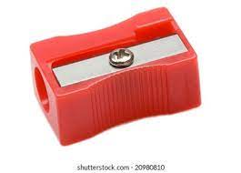
What’s this?
What colour is it?
It’s ________
red

Slide 11
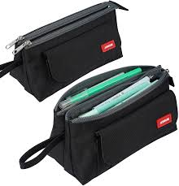
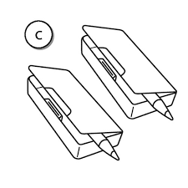
What are these?
What colour are they?
They are ________
black

Slide 12
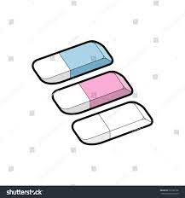
What are these?
What colour are they?
They are ________
white, pink and blue.

Slide 13
What colour is the pen?
It’s …………/It is……………
What colour are the penS?
They are………/they’re….

Slide 15
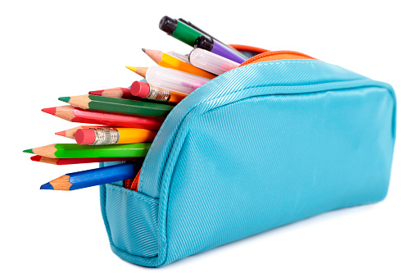
white
yellow
orange
red
pink
green
blue
purple
brown
grey
blue
It’s _______.
black

Slide 16
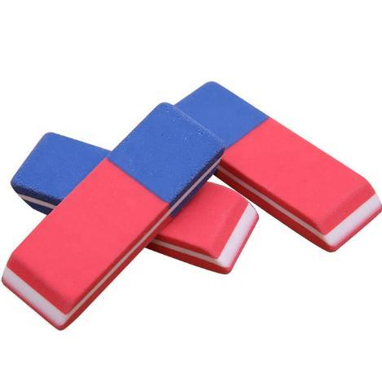
white
What colour are the rubbers??
yellow
orange
red
pink
pink
green
blue
blue
purple
They are
_______.
brown
grey
Pink and blue
black

Slide 17
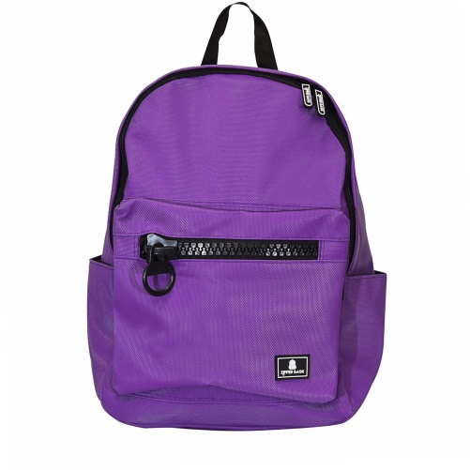
white
yellow
orange
red
pink
green
blue
purple
brown
grey
purple
It’s _______.
black

Slide 18
white
yellow
orange
red
pink
green
blue
purple
brown
grey
green
They’re _______.
black

Slide 19
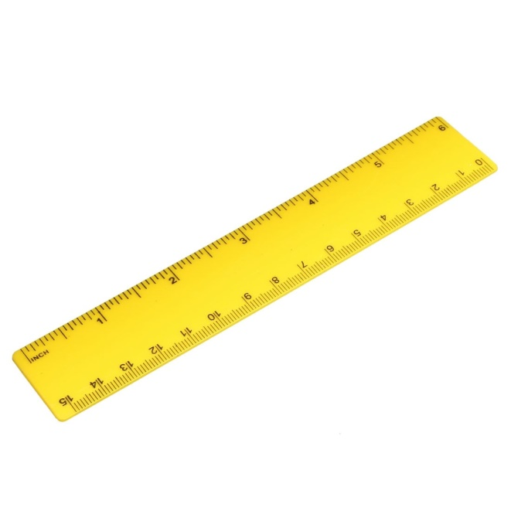
white
yellow
orange
red
pink
green
blue
purple
brown
grey
yellow
It’s _______.
black

Slide 20
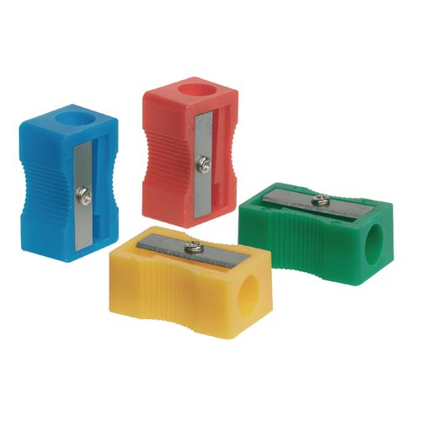
white
yellow
orange
red
pink
green
blue
purple
brown
grey
They’re _______.
blue
black

